Slide 1
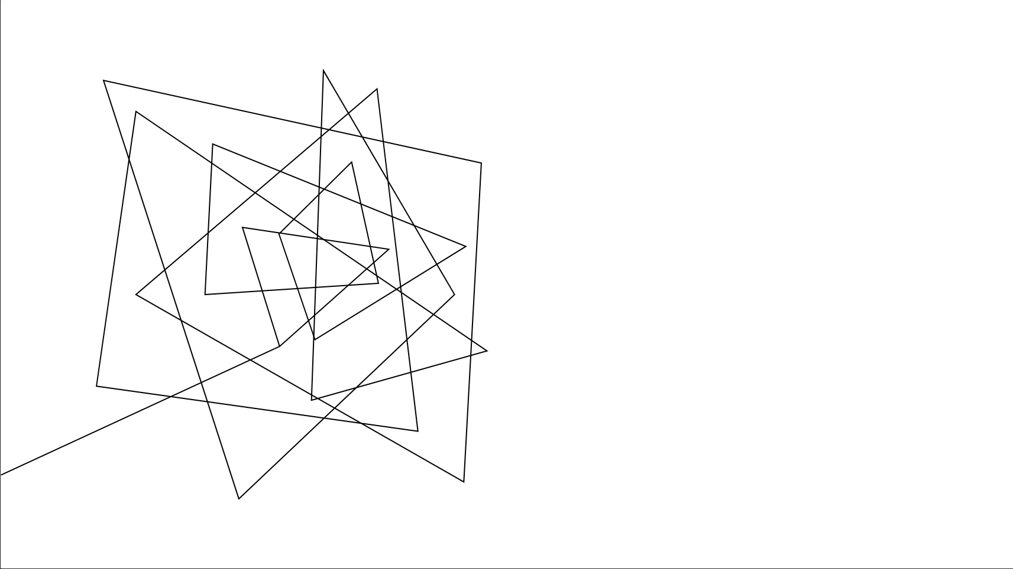
Dr. Pill
Automatic Pill Dispenser

Slide 2
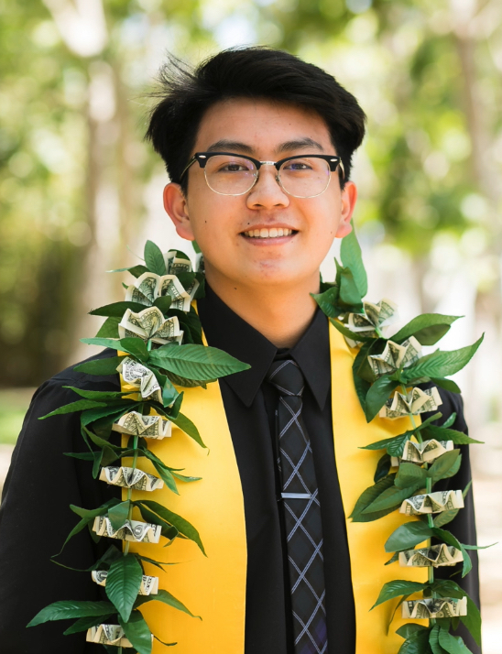
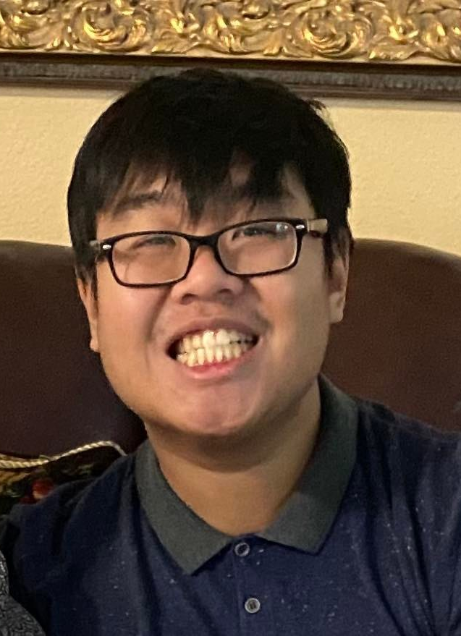
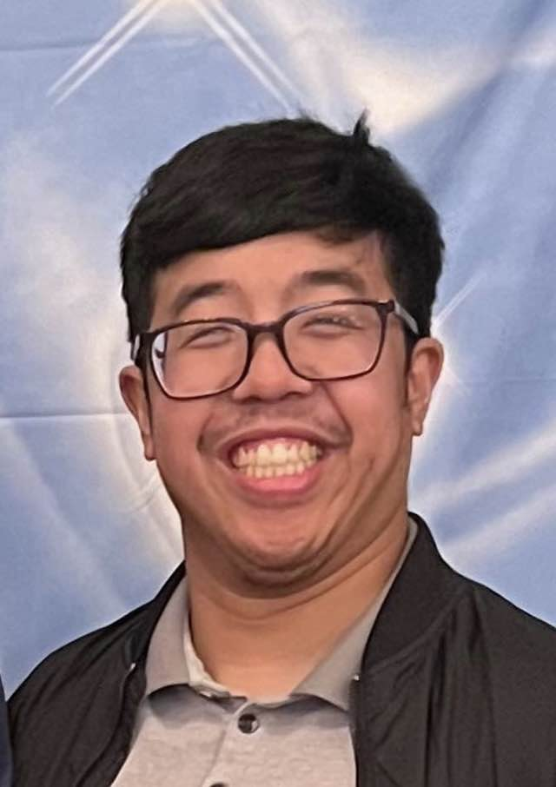
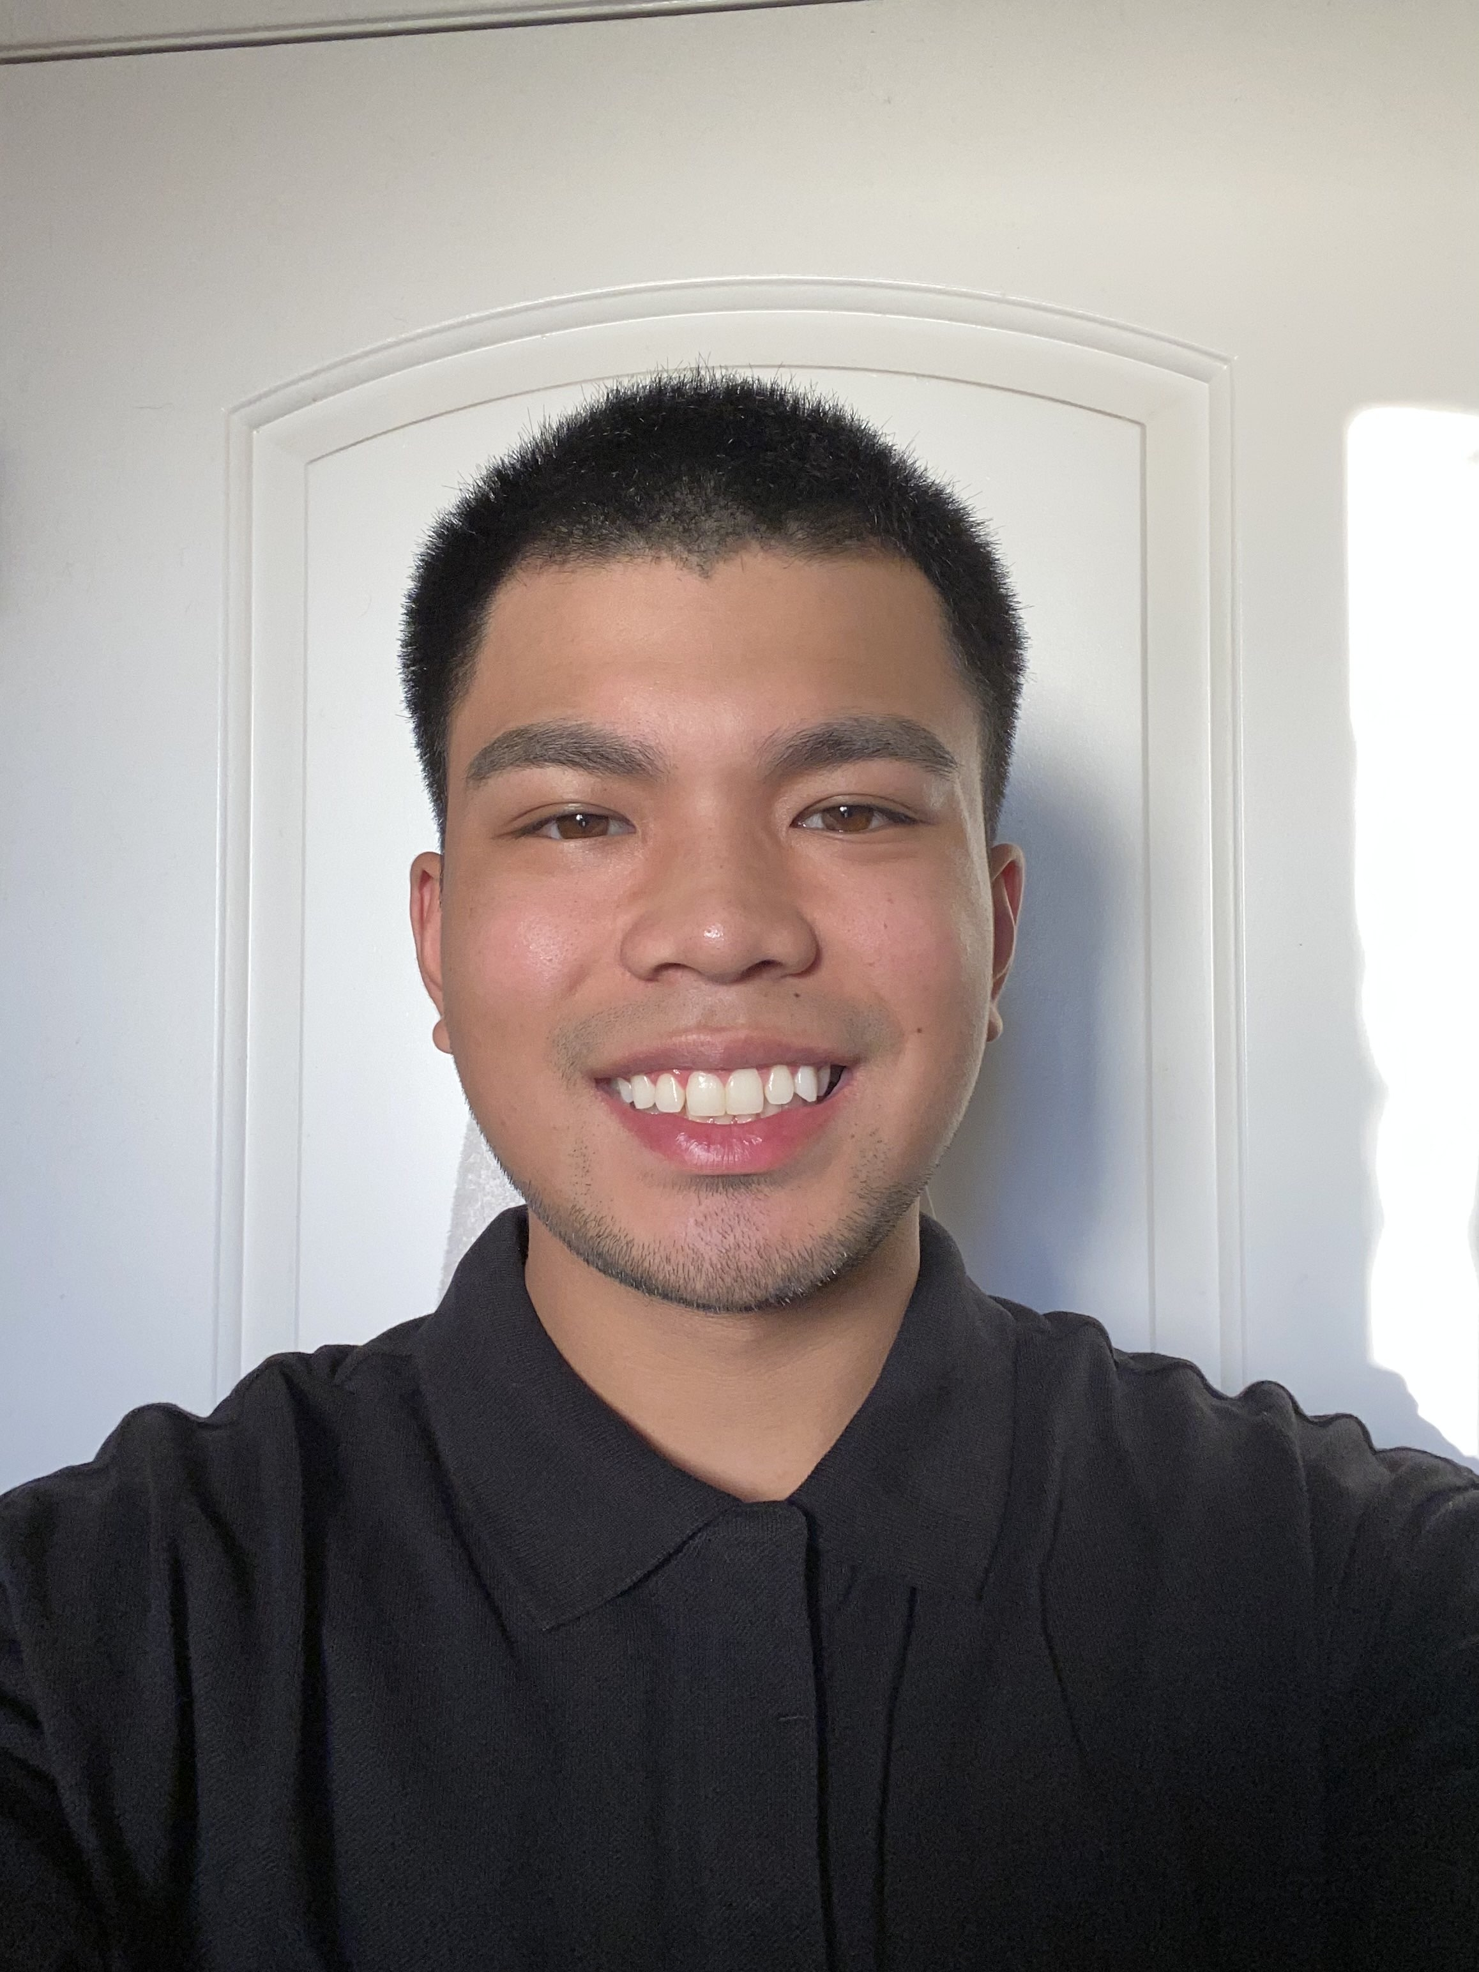
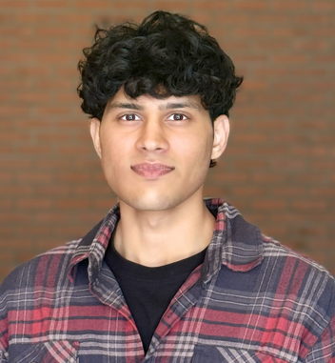
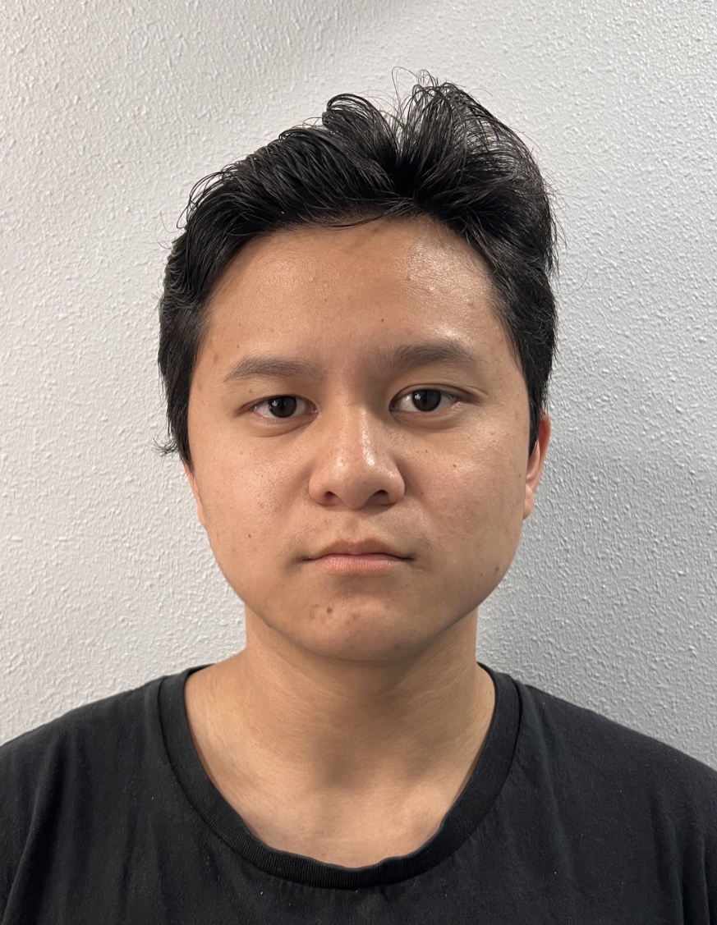
Team and Responsibilities
Jonathan Cerniaz
Jehmel
Espiritu
Jeremy Espiritu
Joseph Guzman
Afzal
Hakim
Lee Roger
Ordinario
Circuit
Power Supply and Regulation
Fingerprint and Facial Recognition
Software Development of Interface
Software Development of Interface
Enclosure & Framework
3D Design and Build
Motor Testing & Calibration
Fingerprint and Facial Recognition
Log tracking and Security
Pill Storage System and Organization
Soldering

Slide 3
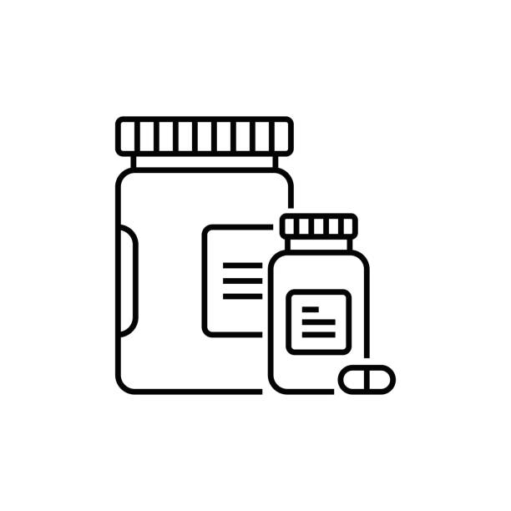
Executive Summary
Dr. Pill is an automatic pill dispenser that simplifies medication management. Our device aims to facilitate the process by freeing up more time for doctors and allowing patients to take their medication accurately by eliminating the common issue of medication errors and missed dosages.
Designated for pharmacies, nursing homes, personal households.
Dr. Pill

Slide 4
OUR 3 DEMOS
Dispense Mechanism & Storage​
2. Displaying User Interface​
3. Authentication and Board to Board Communication
Final: 'Dr. Pill'
The Automatic Pill Dispenser
Dr. Pill

Slide 5
Final demonstration
'Dr. Pill' The Automatic Pill Dispenser
Requirements: Accumulation of all demos + Real-Time Logging, Add/Delete User, Conveyor Belt
Constraints: Log accuracy, facial and fingerprint recognition accuracy
Success: Logs show real-time activity, conveyor belt brings pills to the front, adding/deleting user
Dr. Pill

Slide 6
DEMO TIME

Slide 7
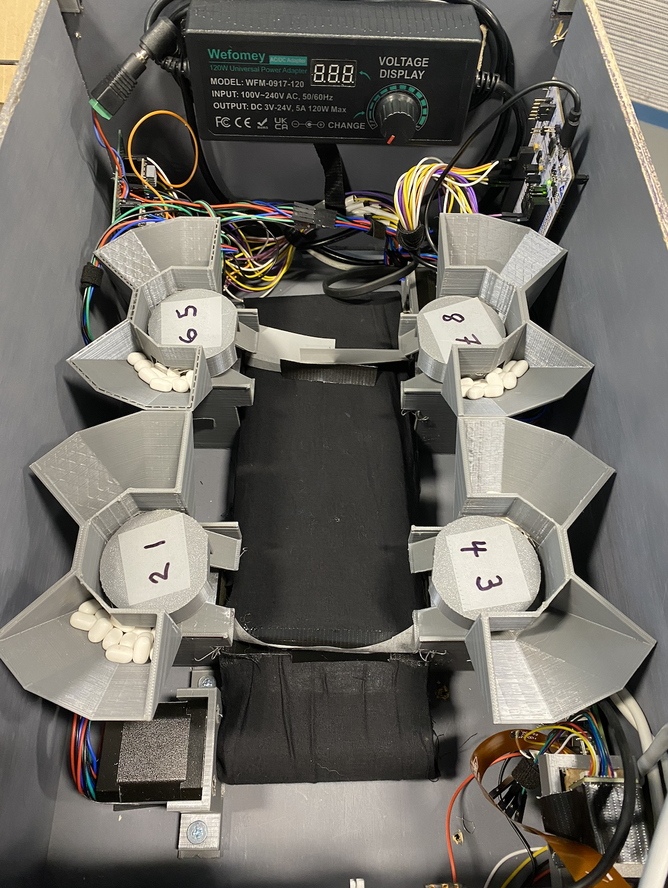
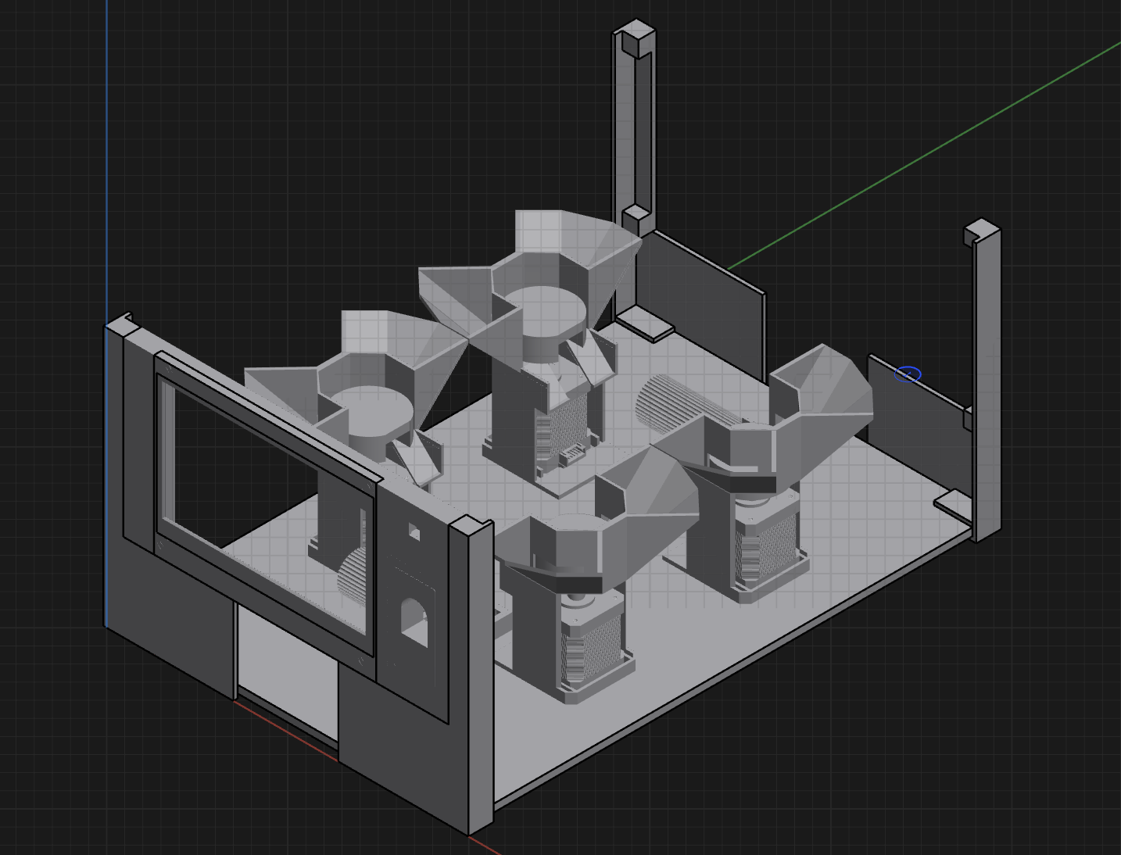
Technical details
Dr. Pill

Slide 8
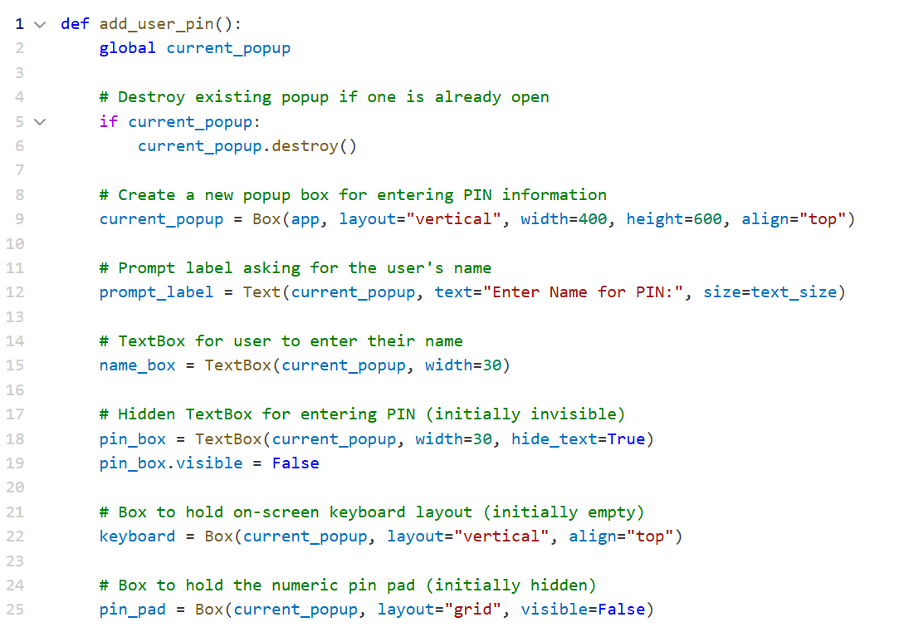
Technical details
Dr. Pill

Slide 9
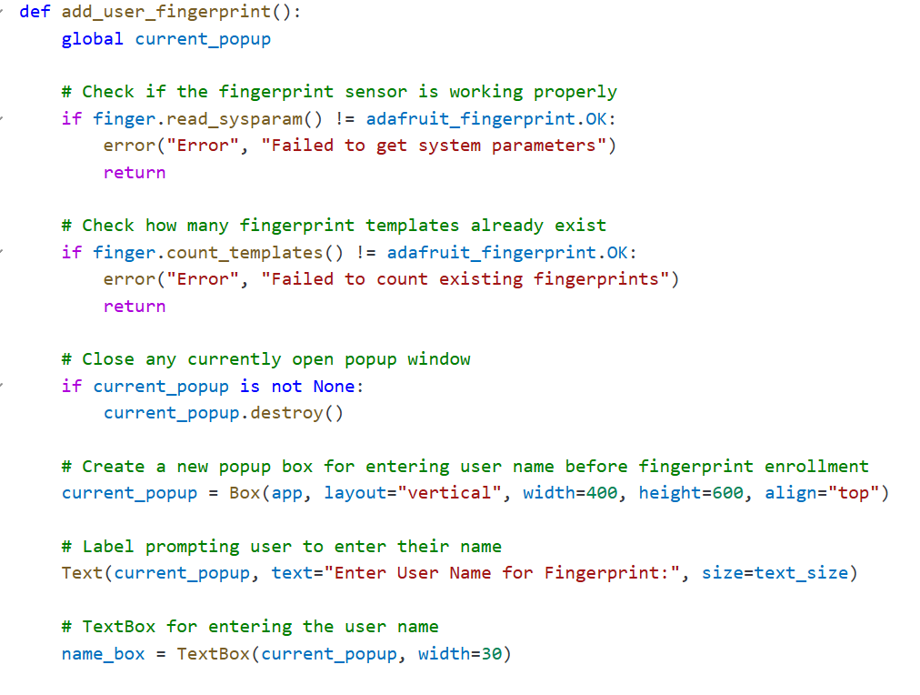
Technical details
Dr. Pill

Slide 10
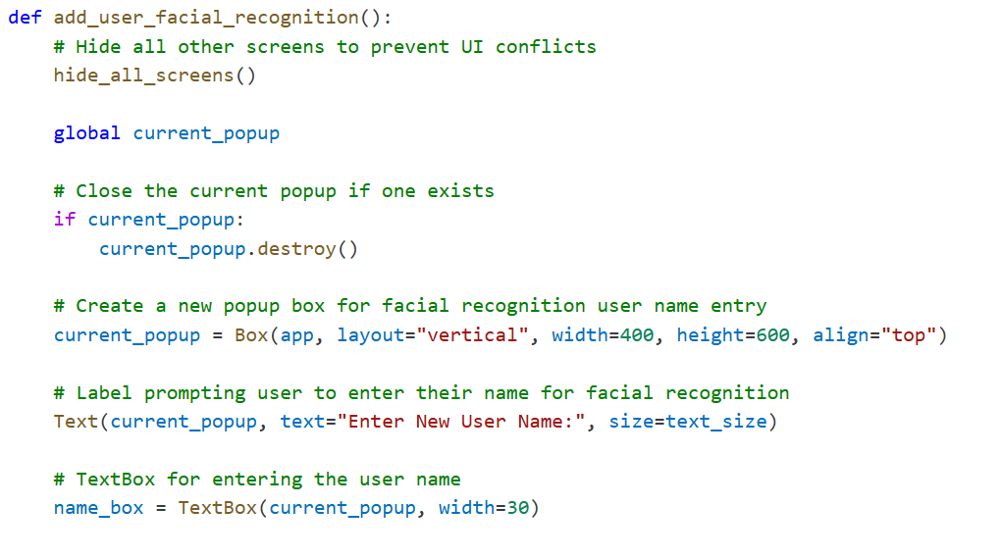
Technical details
Dr. Pill

Slide 11
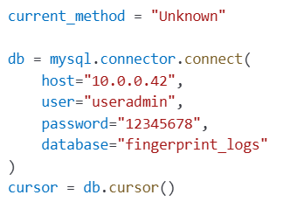
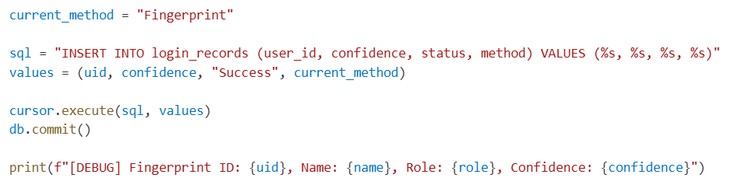
Technical details
Dr. Pill

Slide 12
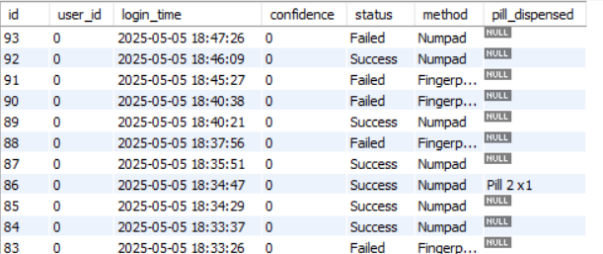
Technical details
Dr. Pill

Slide 13
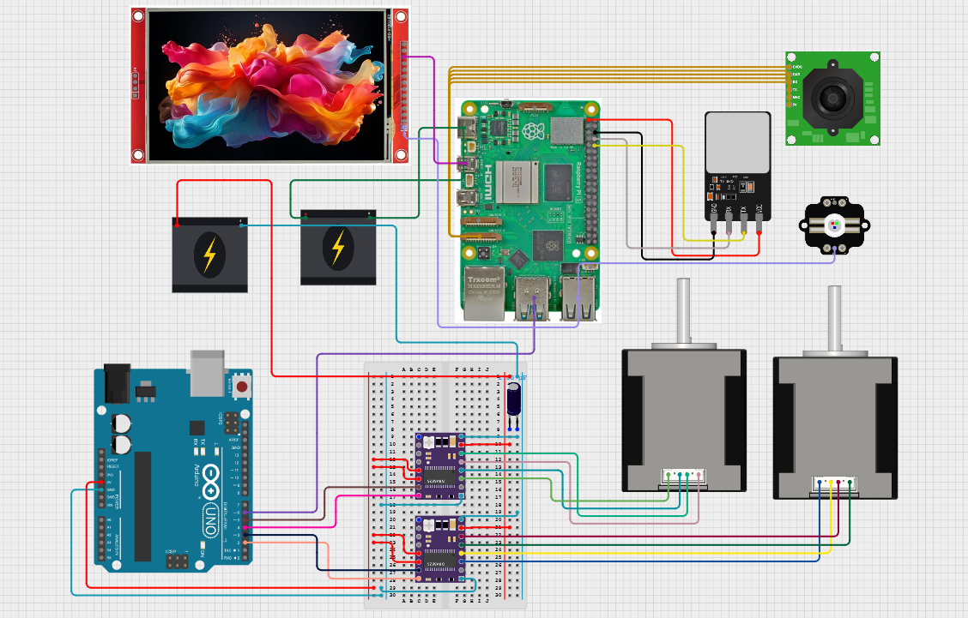
Technical details
Dr. Pill

Slide 14
Challenges and how we solved it
3D printing issues (clogging, broken nozzel, poor print quality, etc.)
Wi-fi connectivity (Mango Wi-fi router)
Dispensing (Object recognition, jamming, pill size, and unpredictability)
GUI (Crashing, quality of interface, and multiple menus)
Dr. Pill

Slide 15
Reflection
We all learned a lot from this class like learning how 3D print, creating logs with MySQL, Fingerprint and Facial Recognition, creating a custom GUI from scratch.
We also learned the fundamentals of working as a team (team communication, time management, planning, etc.)
Since we were only missing the object recognition that leaves us with 95% of the project being complete. If we were to continue this project there it a lot we could improve on in the future (Cleaner GUI, object recognition, better enclosure, etc.)
Dr. Pill

Slide 16
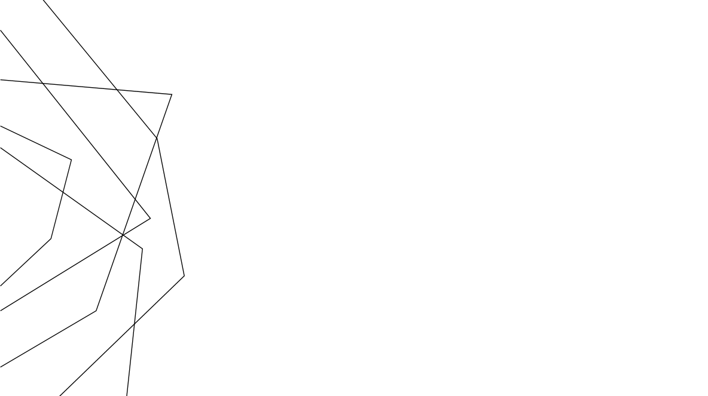
Thank You
Dr. Pill

